Slide 1
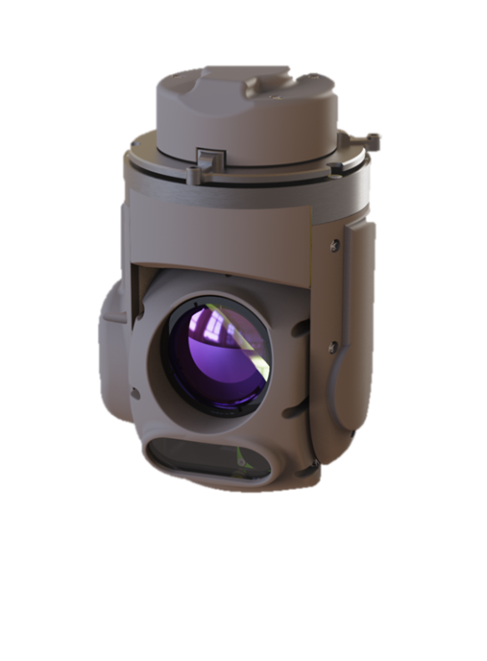
Integration Options

Slide 2

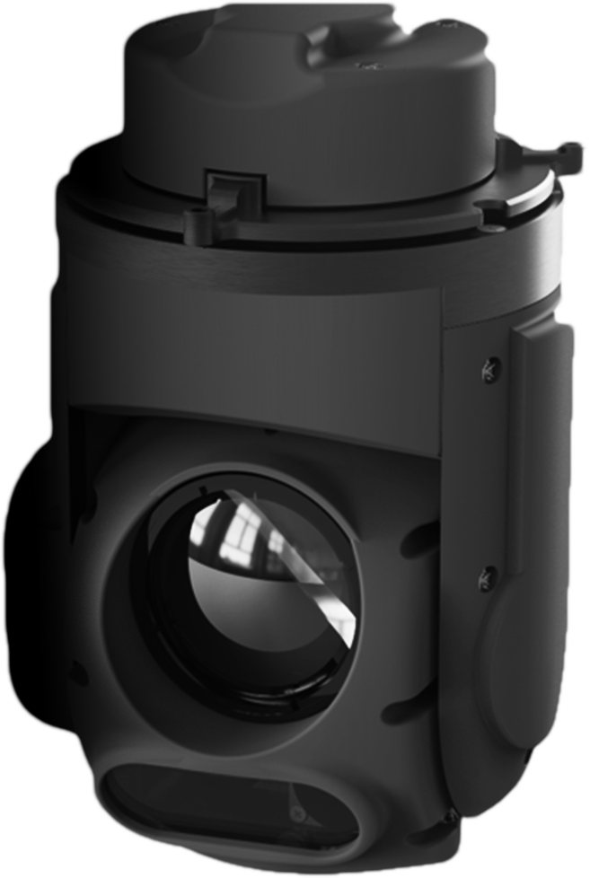


Integrations Options

Slide 3
Integration Overview: From Lab to Mission
Level | Integration Level | Options | Discription | Can Be Used For- |  |  |  |  | Time to Video | Time to Test Flight | Time to Fully Operation Readiness
 |  |  |  | Initial Evaluation & Lab Demos | Basic Test Flight (External PC) | Test Flight + HIVE (CPU) | Test flight w/o HIVE | Fully Operational Flight
1 | Fast Integration Payload PC + GCS* | Operation Kit | Full operation kit – Plug & play | V | V | V | V | V | 10 Mins | 1 Day | 2-4 weeks
2 |  | Basic Operation | We supply – Payload + HIVE (CPU) & cables Electric & Mechanic Integration is on you |  | V | V | V | V | 15 Mins | 1 Day
3 | Advanced integration into GCS | HIVE + SDK | We supply – Payload + HIVE (CPU) & cables Electric, Mechanic and Software Integration is on you |  |  | V | V | V | 1-2 Days | 3 Days
4 |  | Docker + SDK | Docker Basic checks |  |  |  | V |  | 2 Hours | -
 |  |  | We supply – Payload & cables Electric, Mechanic and Software Integration is on you |  |  |  | V | V | 1-2 Days | 3 Days

Slide 4
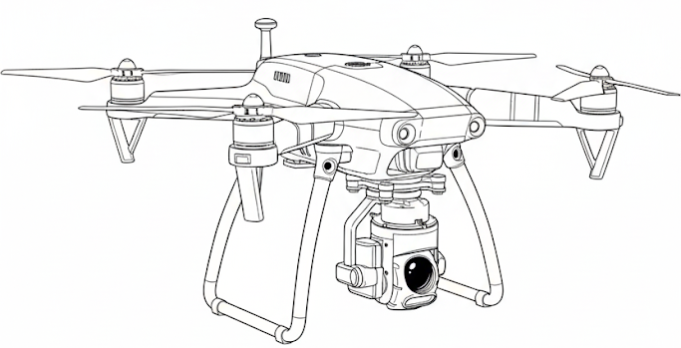
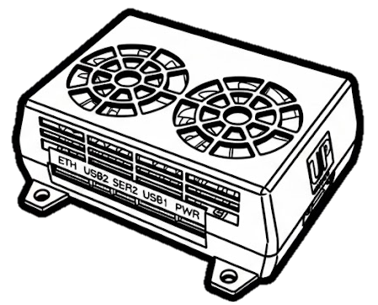

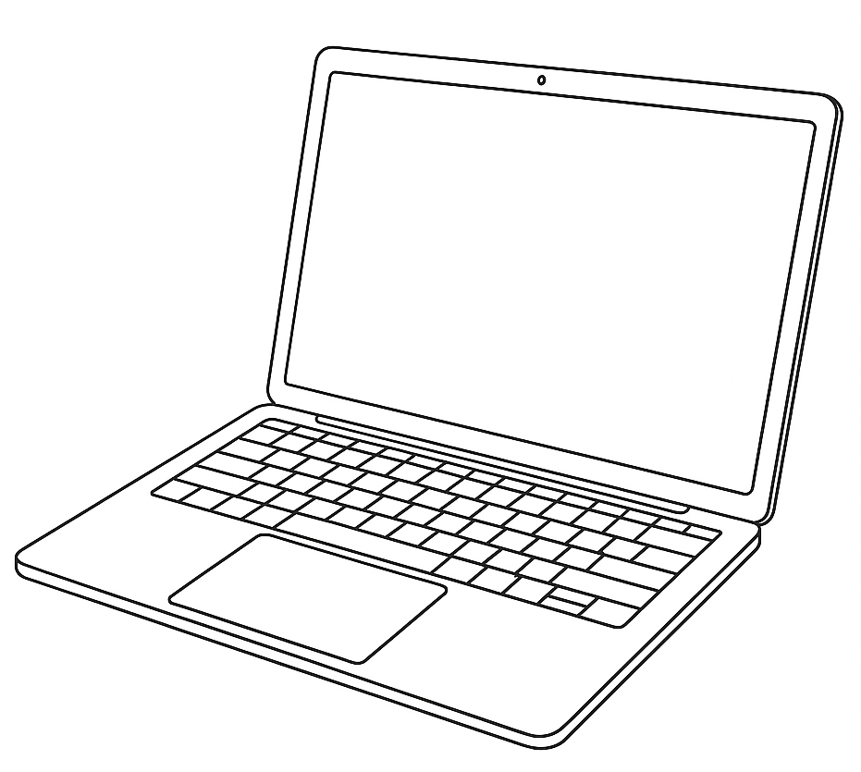

Integration Overview
Our system features versatile Dual-Brain Architecture designed for maximum flexibility:
Aerial Processing: Handles image processing and real-time feedback.
  Select from: HIVE or NVIDIA Jetson Orin.
Ground Control: Manage command execution, and live video feeds.
  Select from: Qbee (Proprietary) or GCS (SDK-integrated).
Total Flexibility Every aerial component is plug-and-play compatible with every ground option.
Your Own GCS SW (SDK)

Slide 5
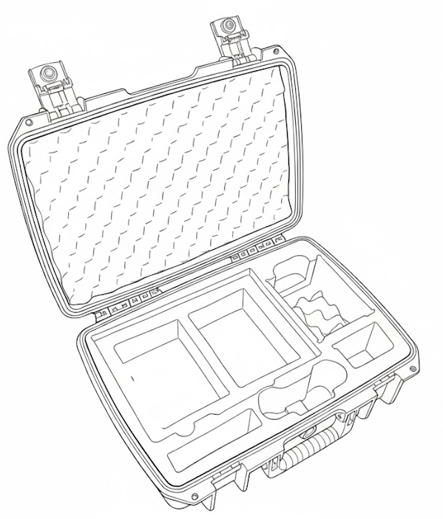
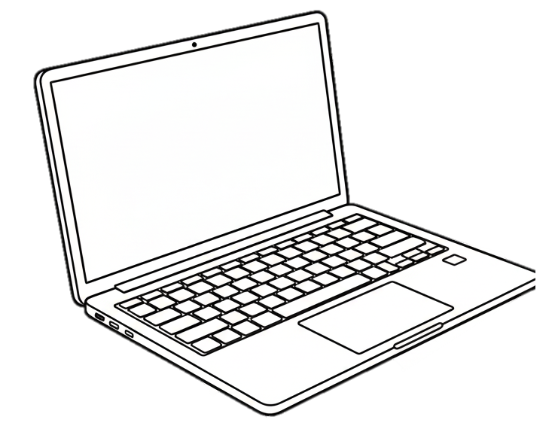
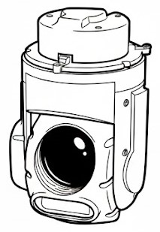
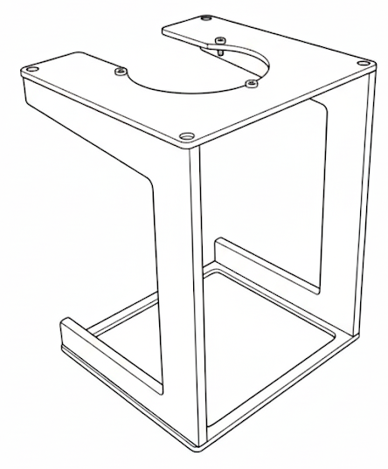
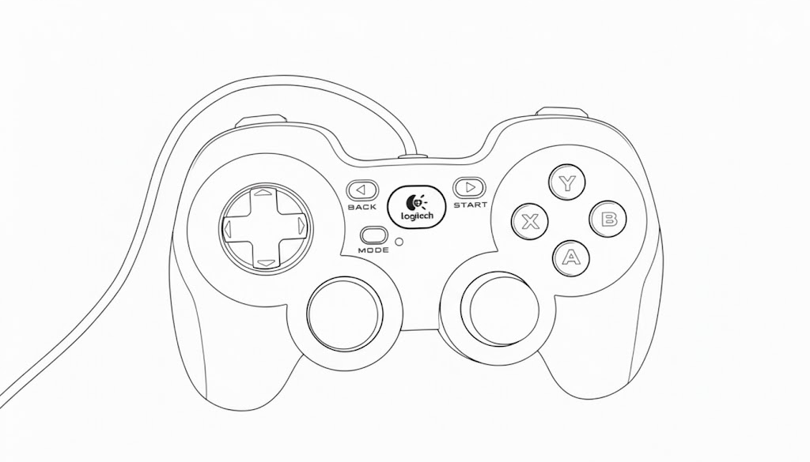
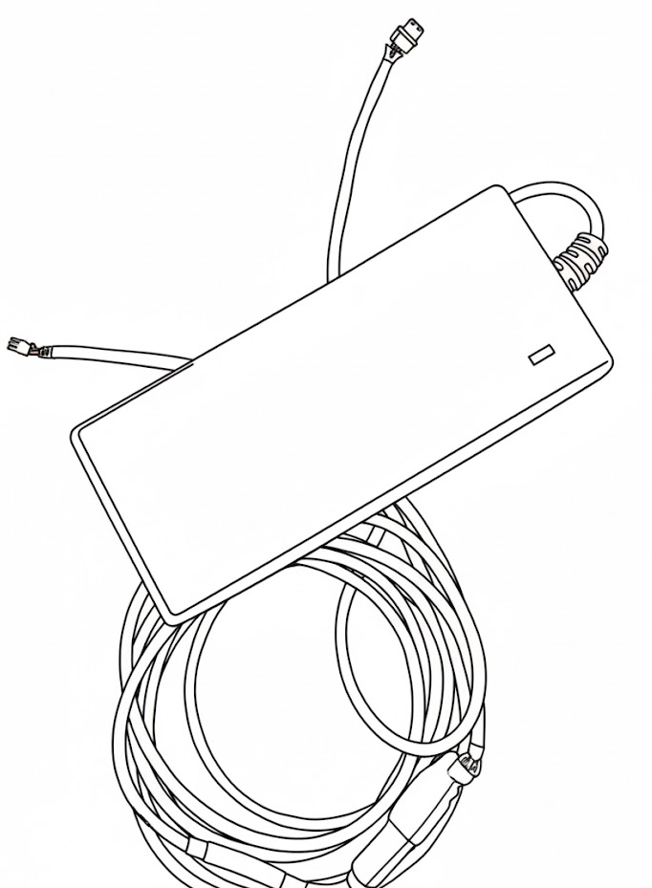
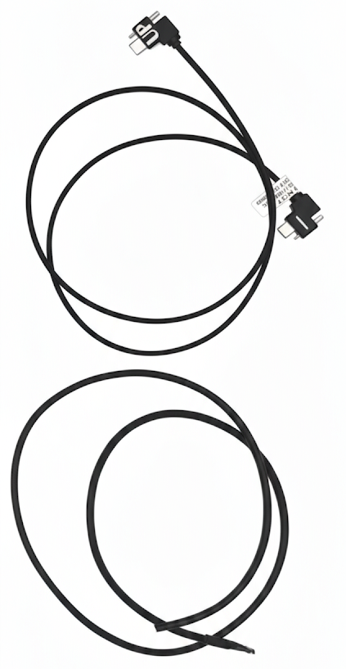
Operation Kit
Option 1 : Full Operation Kit
What’s Inside the Kit:
This is our "Zero Friction" solution.
We provide the entire ecosystem so you can validate the payload immediately.
Your effort: Plug in the power.
Goal: See live video in 10 minutes.
Rugged Suitcase
Lenovo Laptop – including all relevant operation software.
Aluminum Jig.
Operation Joystick.
Cable Set – Which include –
    Power cable to HIVE and Payload (Appendix A)
    Type C to Type C cable connects between the payload and the Hive (Appendix B).
    Ethernet cable to HIVE (Appendix C).

Slide 6
Basic Operation
Option 2: Basic Operation
Docker Basic Integration
Ideal if you already have a lab setup but want to use our HIVE processing unit.
We Supply: Payload, HIVE (CPU), SW, Cables and any other necessary ICDs .
You Supply: PC, Power Supply (24-32V(, Mechanical Mount, and Joystick.
Goal: Live video in 15 minutes.
Specifically designed for teams already standardized on the NVIDIA Jetson Orin platform (Jetpack 5.x/6.x).
We Supply: Payload, Docker Image, SW, Cables and any other necessary ICDs.
You Supply: Jetson Orin NX jetpack 5/6X, carrier with type-c connection, PC and Mechanical Mount.
Goal: Environment up and running in 2 hours.

Slide 7
The Professional Integration (SDK)
These options are for clients building a proprietary drone platform or Ground Control Station (GCS).
Option 3: Payload + HIVE + SDK
Option 4: Payload + Docker + SDK
Use our optimized hardware (HIVE)
but take full control of the "brain" using your own ground software.
We Supply: Payload, HIVE (CPU), SW, Cables and any other necessary ICDs include SDK API & Documentation.
You Supply: The Drone/Platform, Mechanical Mount, Power Supply (24-32V( and Ethernet connection.
Timeline: 24-48 hrs for basic feed; 2-4 weeks for full Operational Readiness.
The deepest level of integration. Our payload becomes a native part of your Jetson-based architecture and your custom GCS.
We Supply: : Payload, Docker Image, SW, Cables and any other necessary ICDs.
You Supply: Your Jetson-based platform, Power Supply (24-32V(, Mechanical Mount and Type-C connectivity.
Timeline: 24-48 hrs for basic feed; ; 2-4 weeks for full Operational Readiness.

Slide 8
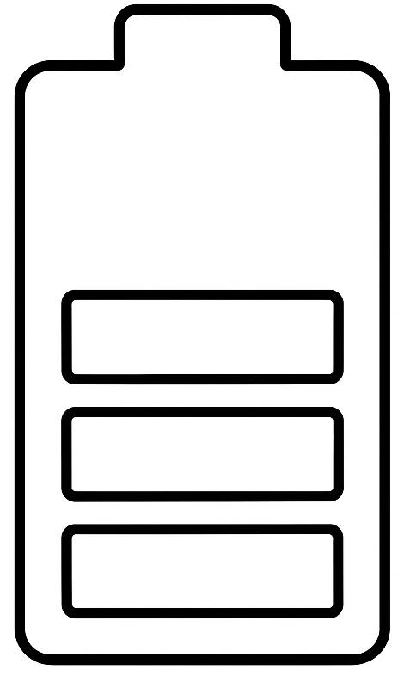
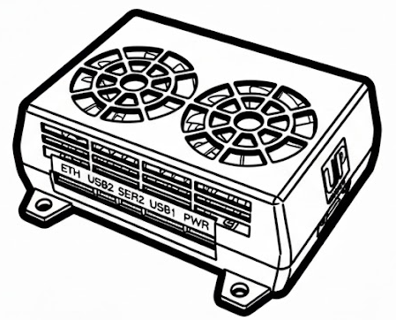
Full Operation Kit / Basic Operation
To execute proper integration of Micro Sting Payloads you need to make sure you have the following items –
Micro Sting Payload
Micro Sting CPU (HIVE)
Laptop with QBee installed - NOTE : Please ensure that your computer doesn't have any special security settings or protections that might block the QBee software.
The laptop will use you to control :
    QBee – the operation software
    WebAcces – The web interface of the HIVE
Payload Stand / adapter
Control Joystick - Logitech Gamepad F310
System test harnesses
  ILS Main Cables:
    Power cable to HIVE and Payload (Appendix A)
    Type C to Type C harness connects between the payload and the Hive (Appendix B).
    Ethernet Cable To HIVE (Appendix C).
Appendix list –
    Appendix A – Power to HIVE & Payload Harness
    Appendix B – Type C To Type C Cable
    Appendix C – Ethernet Cable To HIVE
    Appendix D – payload mechanical ICD
    Appendix E – HIVE mechanical ICD
24-32V Power connection
Ethernet connection
to Platform / Computer
Type C to Type C cable

Slide 9
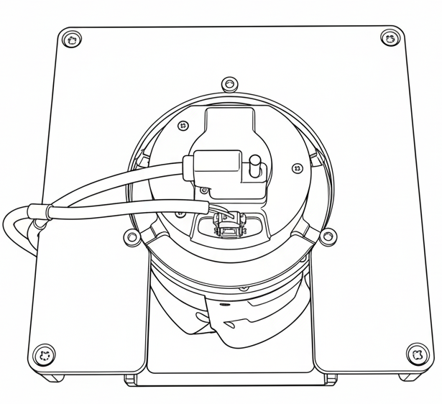
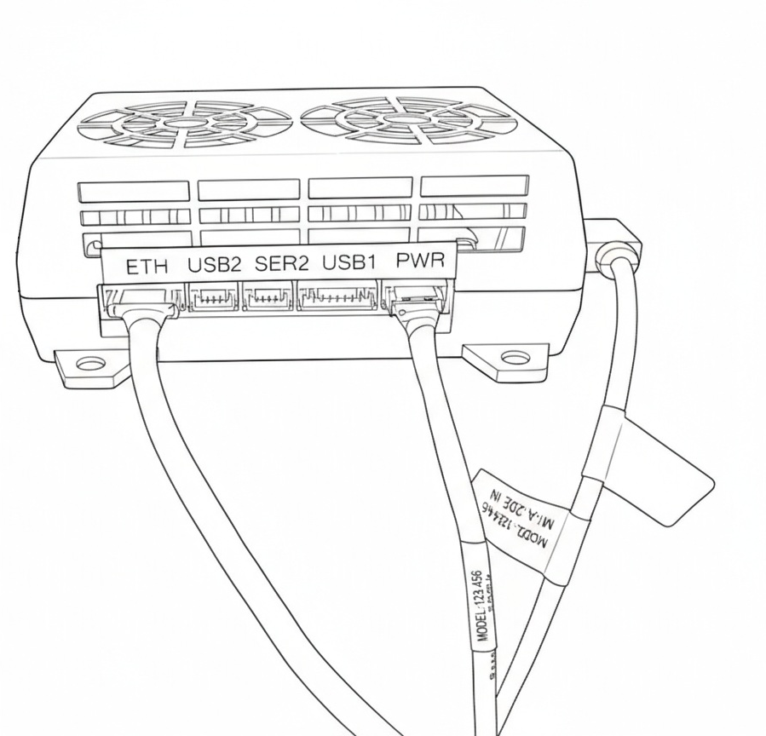
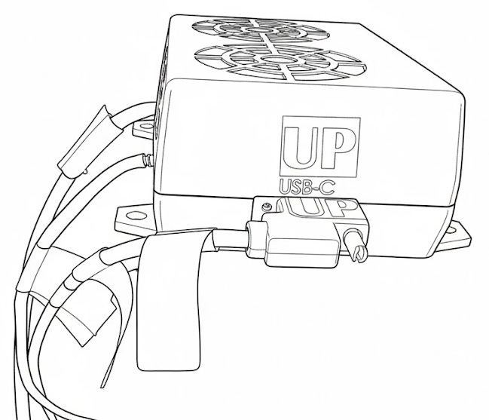
Full Operation Kit - connections
Harness connection Procedure –
NOTE : Verify the main power source is unplugged before starting. Do not make any cable connections while the system is under power.
HIVE Connections -
  Ethernet cable – Connect To Hive
  Power Cable – Connect to HIVE
  Type C Cable – Connect to HIVE (ensure the orientation matches the "UP" sticker)
Payload Connections -
  Type C Cable – Connect
  Power Cable – Connect
Ethernet Cable – Connect to PC
Main Power cable – connect to power source
4
2
5
1
3

Slide 10
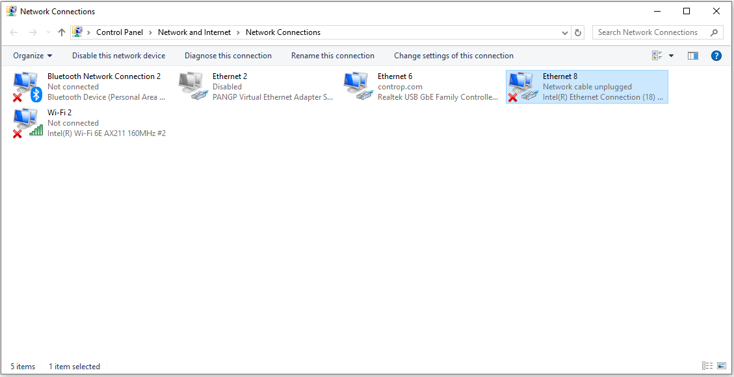
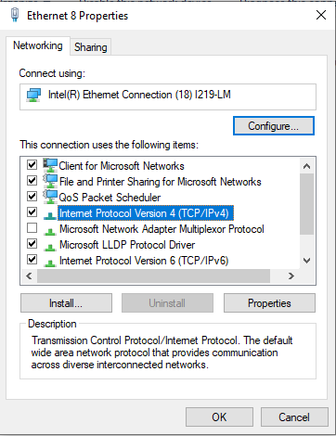
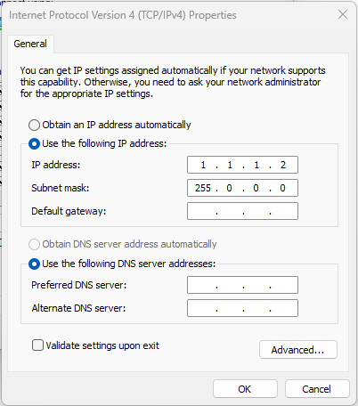
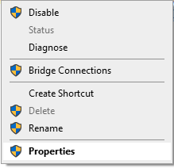
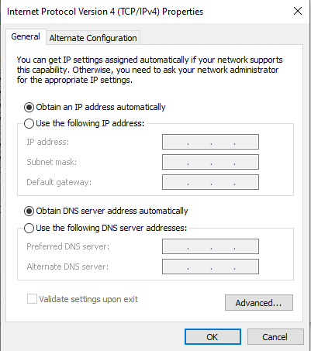
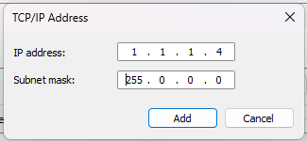
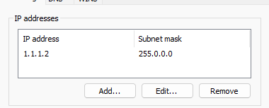
Basic Operation
To ensure the computer recognizes the payload, we first need to make sure it knows the payload's IP address. Follow the steps below to do this:
Go to “network Connections”
Right click on Relevant “Ethernet”
Connection.
Choose “properties”
Double click on “Internal
Protocol version 4 (TCP/IPv4)”
Insert new IP address:
  IP – 1.1.1.2
  Subnet – 255.0.0.0
Click on “Advanced” and add
new IP Adress –
  IP – 1.1.1.4
  Subnet – 255.0.0.0
Press OK in all open windows

Slide 11
Basic Operation
If you’ve completed all the integration steps but don’t see live video in the QBee App, follow these steps to resolve the issue:
Click the Start button.
Type “firewall” in the search bar.
Select “Allow an app through Windows Firewall.”
In the window that opens, click “Change settings.”
Locate the applications “generic.exe” and “videoplayerwpf.exe.”
For each of these apps, ensure that both checkboxes are selected:
  Private
  Public
Click “OK” to save the changes.
Close all windows and restart the QBee application.
√
√

Slide 12
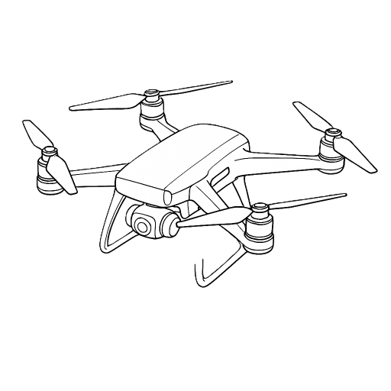
Docker Basic Integration
If your drone is using an Nvidia Jetson Orin NX (JetPack 6/5.x), you can replace the HIVE hardware by installing our BeeKeeper software via Docker.
Why switch to the Docker version?
          Lower Weight : Increases payload capacity or flight time.
          Lower Costs : Eliminates the need for additional HIVE hardware.
          Compact Design : Saves valuable space inside the airframe.
To ensure a smooth integration, please verify that your hardware meets the following requirements for our camera.
Hardware Requirements -
Data Interface: A USB Type-C port must be available on your Jetson carrier board.
Power Supply: A dedicated 24V–32V power connection is required.
Quick Start :
Connect to your Jetson and move the Docker package to the User Directory.
Follow the step-by-step guide located in the README file within the folder.
Total Installation Time : Approximately 90 minutes.
Post-installation, payload operation remains identical to the standard HIVE configuration.
24-32V Power connection
Type C to Type C cable

Slide 13

Payload + HIVE + SDK
Alternatively, you may choose to keep the existing hardware configuration (Payload + HIVE) while integrating the payload controls directly into your own operating software via our SDK.
Integration Steps:
Maintain the current hardware setup on your aircraft.
Access our SDK Documentation for comprehensive API references.
Follow the implementation guide to bridge our payload functions with your custom software.
Estimated Timeline:
Initial Setup: 24–48 hours for basic command-and-control functionality.
Link to SDK Documantation – XXXX ???
24-32V Power connection
ETH Connection
Type C to Type C cable

Slide 14
Payload + Docker + SDK
The most integrated solution combines our Docker-based payload software with your own custom software interface via the SDK. This removes the need for HIVE hardware and eliminates any "middle-man" interfaces, giving you direct control of the payload within your native environment.
Hardware & Software Requirements:
Data: USB Type-C connection on your Jetson carrier.
Power: Dedicated 24V–32V power supply to the payload.
Files: Access to our Docker Image and SDK API Documentation.
Advantages:
Zero "Middle Agents": Complete, direct control through your proprietary software.
Minimum Footprint: Maximum weight and space savings by utilizing your onboard Jetson Orin NX.
Estimated Timeline:
Total Installation & Integration: ~48 hours for basic operational status.
24-32V Power connection
Type C to Type C cable

Slide 15
Web-Access User Manual

Slide 16
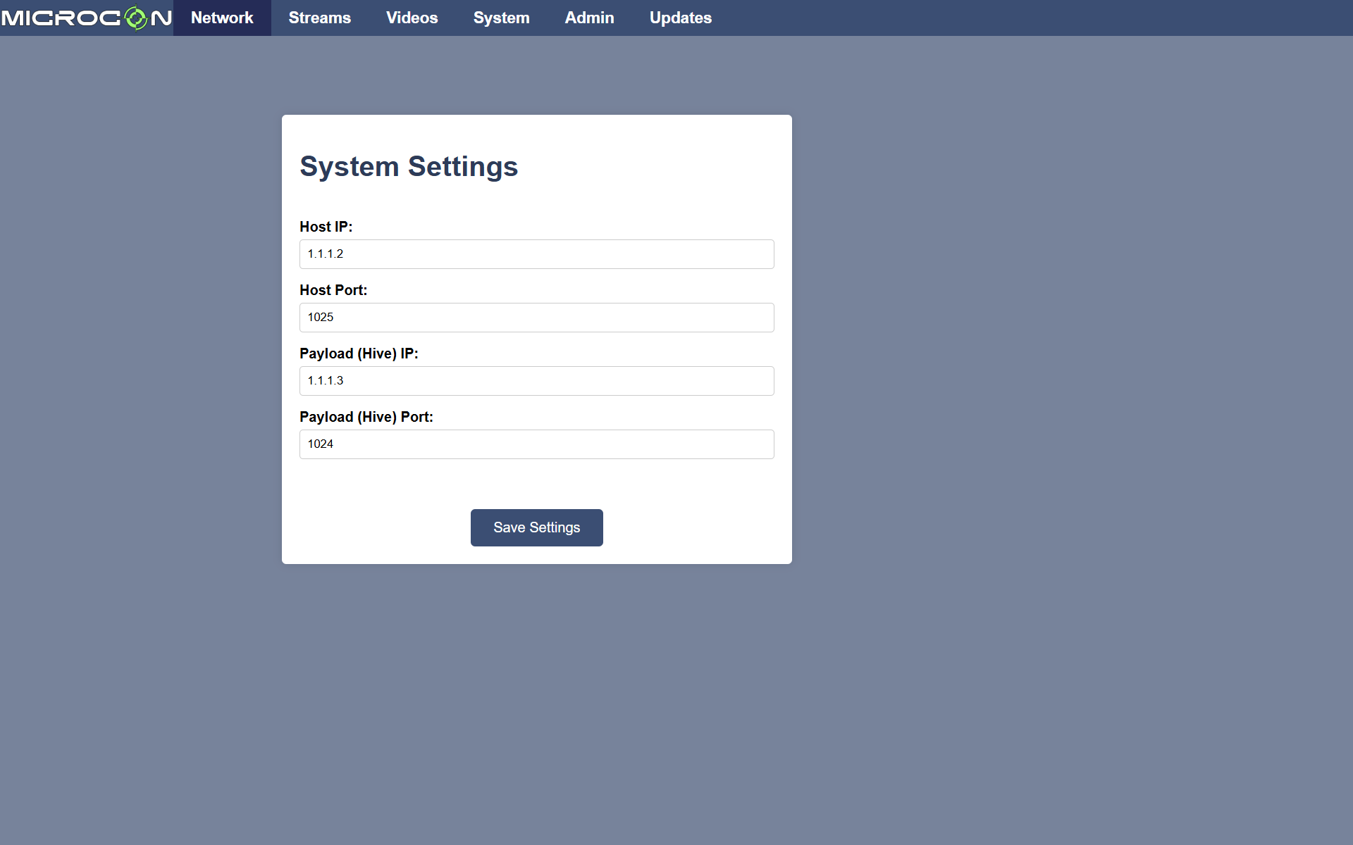
Web-Access Explained
Web Access
Web Access is the operator’s interface for configuring system settings and downloading recorded videos.
In the following slides, we’ll explore each feature available through the Web Access interface.
Accessing the Web Interface
To open Web Access, enter the following address in your browser’s URL bar:
1.1.1.3:8080
Note: This address remains the same even if the Hive IP is changed.
Web Access Layout
As shown in the image, the Web Access interface includes six tabs:
Tabs 1–4: Designed for end users
Tabs 5–6: Reserved for D-level engineers

Slide 17
Network Tab
The Network tab allows you to configure IP addresses and ports for system communication.
Host (Control Station)
This is the main control unit of the system.
Note : Ensure the Host IP matches the IP address you configured in Slide 6.
Payload (Hive Unit)
Represents the Hive device in the network.

Slide 18
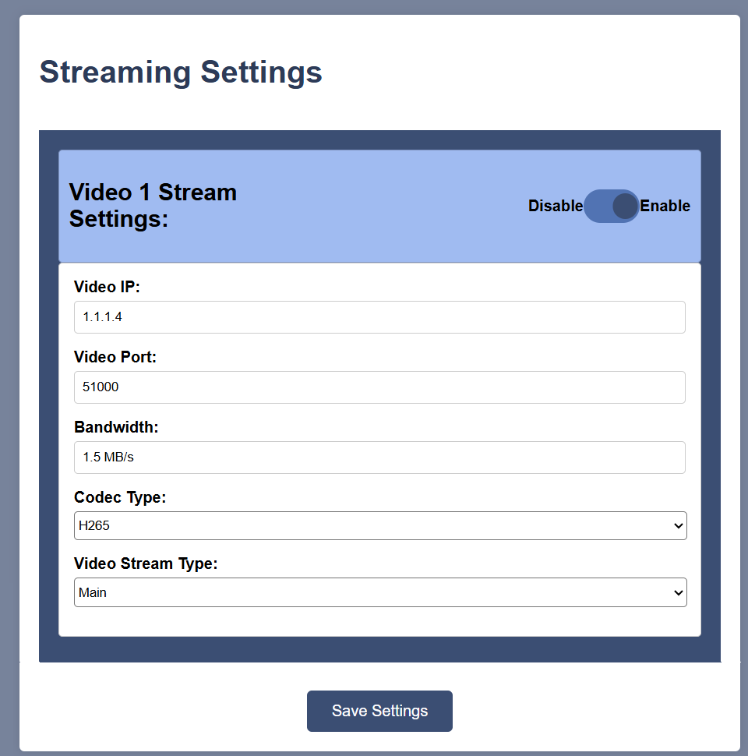
Streams Tab
The system supports three separate video channels, allowing you to configure each stream independently based on your needs.
Video IP – after setting a new IP – make sure to set it in the advanced network connection settings.
Video Port - The specific communication channel used alongside the IP to route the video data correctly.
  Note- make sure each channel gets a different port.
Bandwidth – The amount of data the video stream uses per second, affecting video quality and network load.
  Recommended – 2.5-4 MB/s
Codec Type (H.264/H.265) – The compression format used to encode the video, balancing quality and file size
(H.265 is more efficient than H.264).

Slide 19
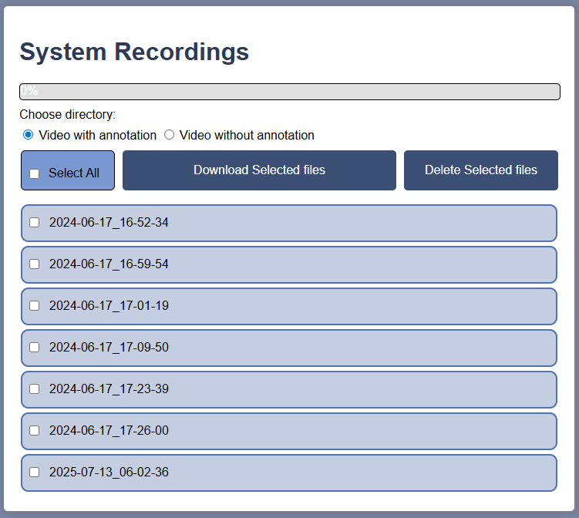
Videos
This section allows you to download recorded videos from the Hive unit to an external device.
File Naming: Videos are automatically named by the date and time of recording.
Annotations: Choose to download videos with or without annotations.
Storage Management: You can delete video files to free up space on the Hive unit.
  Note: If the Hive’s memory is full, new videos will not be recorded.

Slide 20
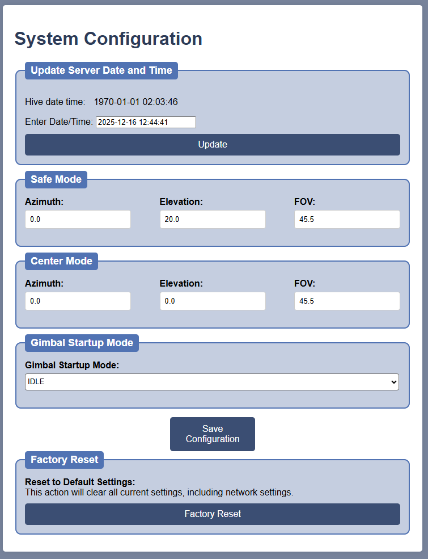
System Configurations
Date & Time Update - Manually set the system’s date and time using the required format, or use the automatic option to sync with your computer’s current settings.
Safe / Center Mode Configuration - Customize the behavior of the payload for both Safe Mode and Center Mode by adjusting their specific parameters.
Gimbal Startup Mode - Customize the Payload mode when power is connected.
(IDLE / Center / INIT etc.)

Slide 21
QBee Operation SW

Slide 22
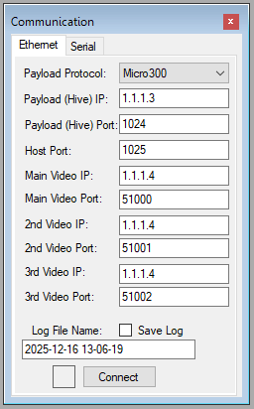
QBee Operating SW
Each time you launch QBee Software, this window will appear first.
Please ensure the following settings match the configuration in WebAccess.
  If all the following parameters matches – press on the “Connect” button.

Slide 23
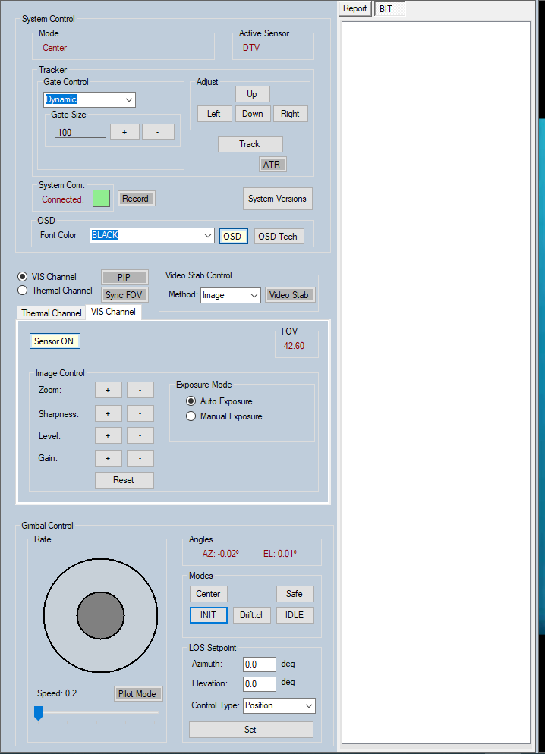

QBee Operating SW
To get a clear picture of how QBee works, let’s break down the three main components of the payload:
Gimbal – The mechanical system that stabilizes the payload and controls its line of sight.
Sensors – The cameras mounted on the gimbal that capture visual data.
Software – The brain of the system. It connects all the hardware (gimbal, sensors, HIVE, etc.), enabling them to work together and analyze the captured images. The software is what brings the entire system to life.
Now that we understand the basics, let’s dive deeper into QBee.

Slide 24
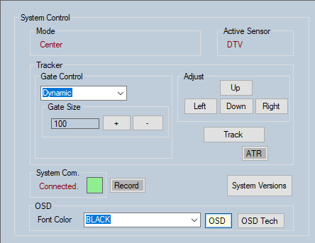

QBee Operating SW
System Control -
This section provides key system indicators and configurable features:
System Indicators :
System Mode – Displays the current operating mode.
Active Sensor – Shows which sensor is active: TI (Thermal) or VIS (Visual).
System Communication – Status indicator:
  🟢 Green = Connected
  🔴 Red = Disconnected
Editable Parameters & Features :
Tracker Mode
  Dynamic – Automatically adjusts gate size based on target.
  Static – Keeps gate size fixed.
Gate Size – Manually adjust the tracking gate dimensions.
OSD (On-Screen Display) –
  Choose annotation colors
  Toggle visibility on the video screen
System Version – Click to view version details in the report screen.

Slide 25
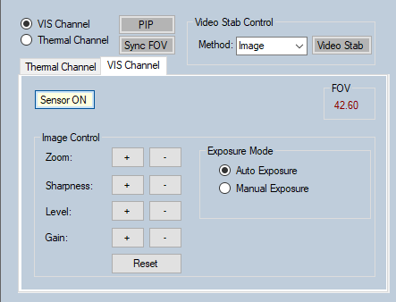
QBee operating SW
Sensor Control -
This tab manages both Thermal and Optical sensors.
The top section is the same in both and includes –
Indicator :
FOV (Field of View) – Displays the current viewing angle of the sensor.
Available Controls :
Sensor Selection – Choose which sensor to display and control.
Lens Control – Zoom In / Out.
Video Stabilization
  Mechanical (via gimbal)
  Mechanical + Software (combined)
PIP (Picture-in-Picture) – Show one sensor in a small window over the other.
Sync FOV – Aligns the thermal and optical views (up to 12.4°).
Sensor ON - Use this option to turn the sensor ON or OFF as needed

Slide 26
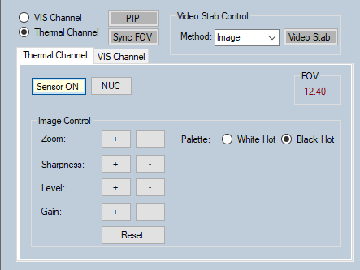
QBee operating SW
Thermal Channel Controls
This section allows you to manage and fine-tune the thermal sensor settings:
Sharpness – Increases or decreases video contrast for better clarity.
Level – Sets the temperature range the sensor will operate within.
Gain – Controls how much temperature data the sensor captures \.
White Hot – Select whether hot areas appear as white or black.
NUC (Non-Uniformity Correction) – Performs a calibration to ensure image quality.
Level -
Gain -

Slide 27
QBee operating SW
VIS Channel Control
This section allows you to manage and fine-tune the VIS sensor settings:
Sharpness – Controls how crisp and detailed the image looks.
Level – Adjusts overall brightness and contrast balance.
Gain – Brightens the image in low light but may add noise.
Manual Exposure – Sets how long the sensor captures light; longer = brighter but can blur motion.

Slide 28
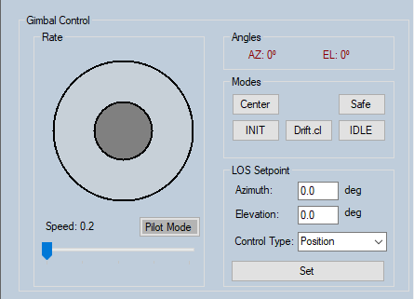
QBee operating SW
Gimbal Control – Quick Overview
Indicator :
Angles
  AZ (Azimuth): Shows horizontal rotation
  EL (Elevation): Shows vertical tilt
Control Features :
Stick Control – Move the gimbal by dragging the grey circle.
Speed – Adjusts how fast the gimbal moves.
Pilot Mode – Reverses pitch control for pilot-style movement.
Modes:
  Center – Moves gimbal to 0° azimuth & elevation.
  Init – Runs a built-in system test.
  Drift.cl – Calibrates motors to prevent drift.
  Ready – Turns off gimbal motors.
  Safe – Moves gimbal to 0° azimuth & 10° elevation.
Position – Set specific azimuth and elevation angles.
Rate – Define how many degrees per second the gimbal should move.

Slide 29
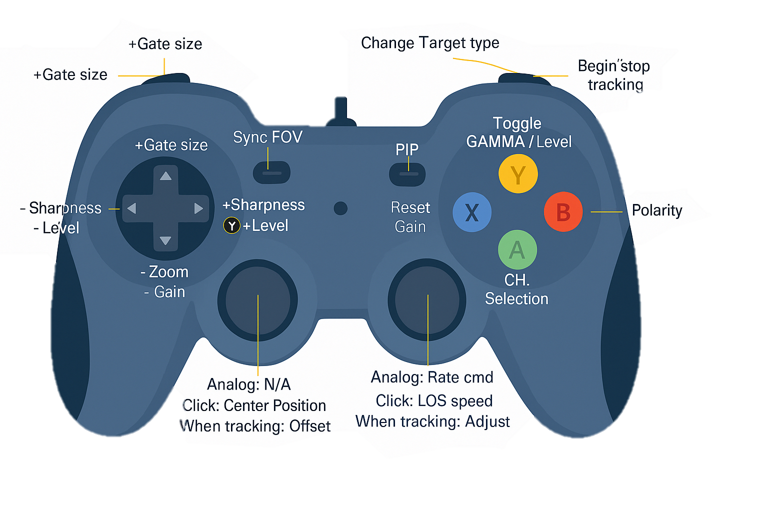
QBee operating SW - Joystick
The QBee can be operated using a standard computer mouse, or alternatively, with a joystick as outlined below:

Slide 30
Appendixes

Slide 31
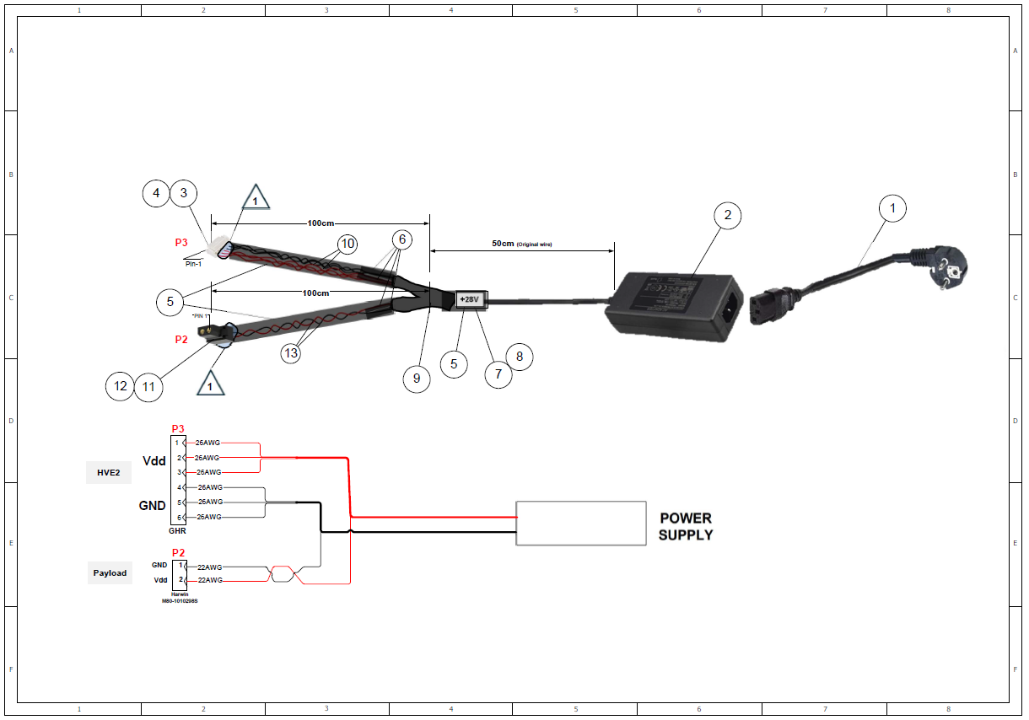
Appendix A – Power to HIVE & Payload Harness

Slide 32
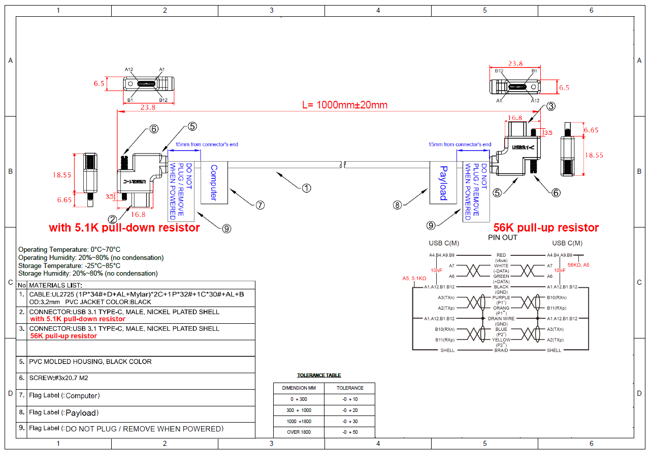
Appendix B – Type C To Type C Cable

Slide 33
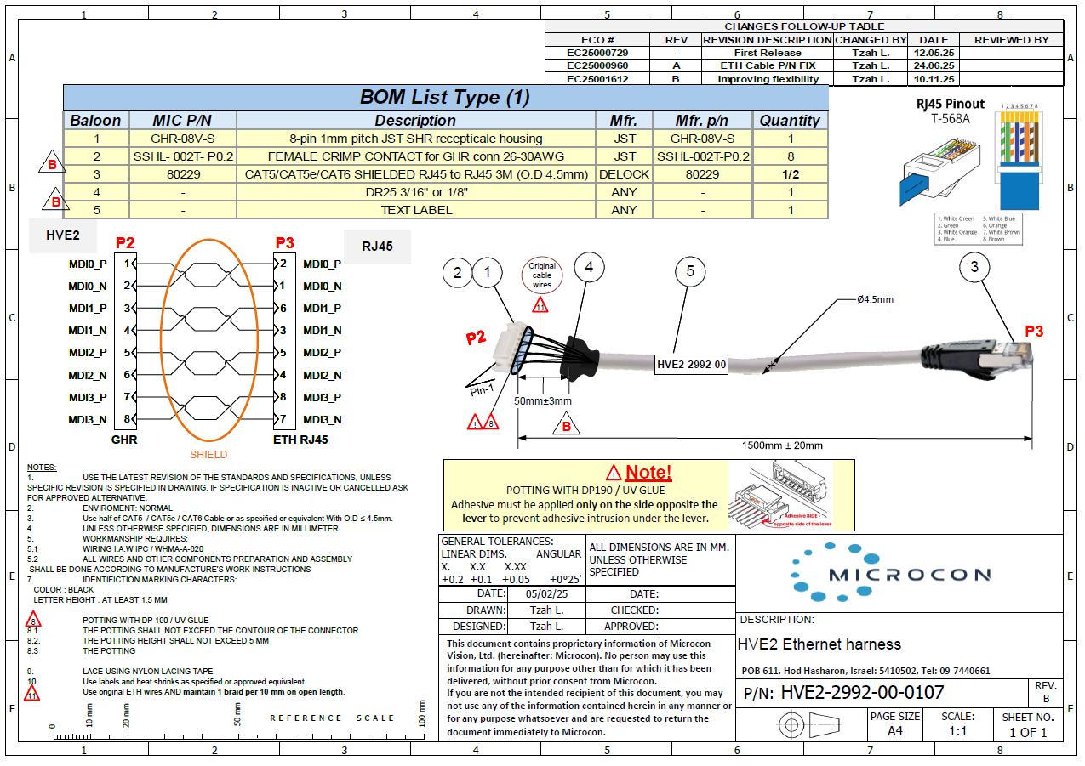
Appendix C – Ethernet Cable To HIVE

Slide 34
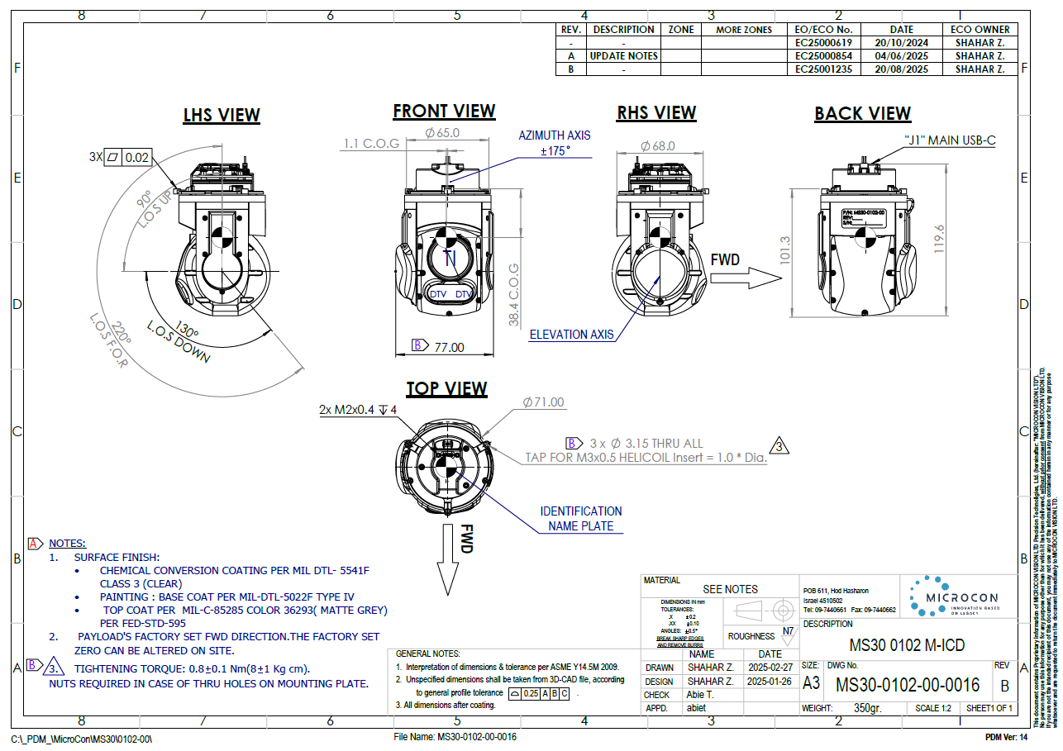
Appendix D – Payload Mechanical ICD

Slide 35
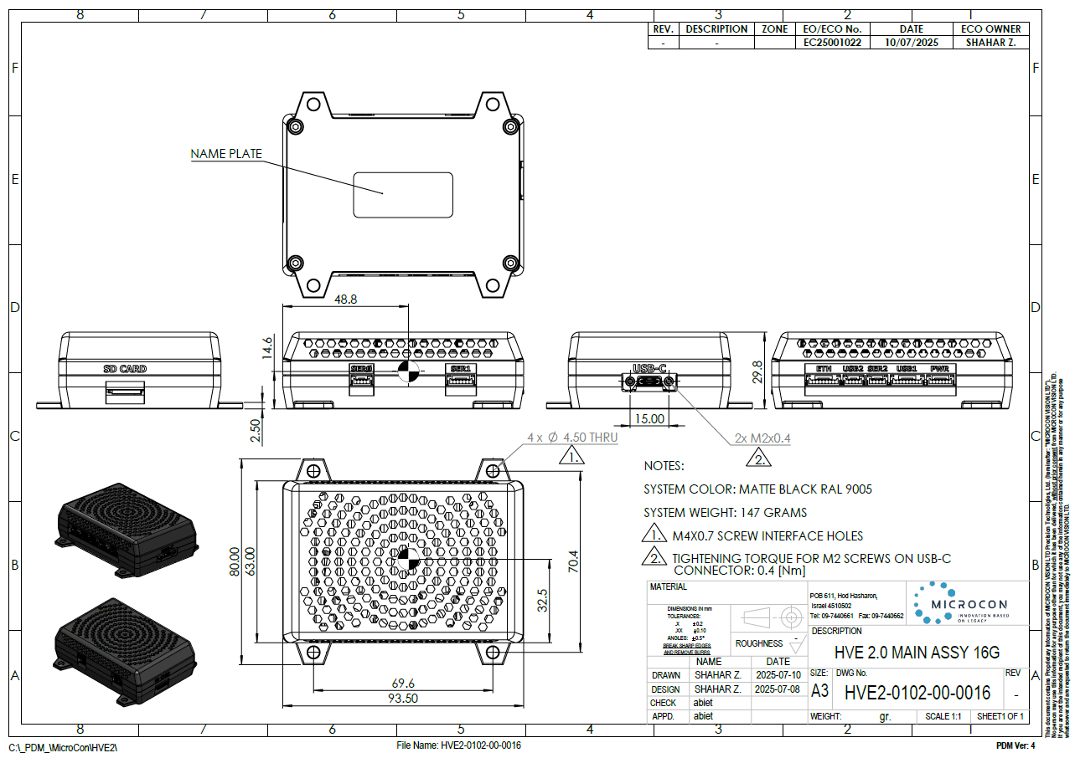
Appendix E – HIVE Mechanical ICD

Slide 36
Micro 300 – General Information
Micro Sting 300
350 gr |  | Weight | Payload – General
24 - 32 VDC (Nominal - 28VDC) |  | Power Consumption
20W | Nominal | Power
120W | Max
±175° | Azimuth | Range
-130° to +90° | Elevation
120°/ sec ±10%. |  | Maximum Angular Velocity
FHD CMOS global shutter |  | Type | Optic Sensors
1920x1080 pixels (2.5 MP) |  | Resolution
0.4-0.7µm |  | Spectral Range
2°- 13° | Narrow | Zoom (FOV)
13°- 45° | Wide
HIVE
Nvidia Jetson Orin NX 8GB |  |  | Inner computer | HIVE
500 GB |  |  | Memory Card
1.1.1.2 |  | Host Computer | Default IP address
1.1.1.3 |  | HIVE
1.1.1.4 |  | Video
255.0.0.0 |  |  | Subnet mask
1.1.1.3:8080 |  |  | Web access URL
1024 | Host Computer |  | Default port
1025 | HIVE
Nominal – 2 Mbps |  |  | Bandwidth
Indium Antimonide (InSb) Focal Plane Array (FPA) | Type | Thermal Sensor
640 × 480 pixels | Resolution
8–14 µm Long-Wave Infrared, LWIR | Spectral Range
3.1°-12.5° Continuous electronic zoom | Zoom (FOV)
Notes:
להפוך שקופית ראשונה לגנרית

Slide 37
Micro 600 – General Information
Micro Sting 300
580 gr |  | Weight | Payload – General
24 - 32 VDC (Nominal - 28VDC) |  | Power Consumption
20W | Nominal | Power
120W | Max
±175° | Azimuth | Range
-140° to +90° | Elevation
120°/ sec ±10%. |  | Maximum Angular Velocity
High Resolution CMOS global shutter | Type | Optic Sensors
5MP 2448x2048 | Resolution
0.4-0.7µm | Spectral Range
Continues Zoom 53° - 2° | Zoom (FOV)
HIVE
Nvidia Jetson Orin NX 8GB |  |  | Inner computer | HIVE
500 GB |  |  | Memory Card
1.1.1.2 |  | Host Computer | Default IP address
1.1.1.3 |  | HIVE
1.1.1.4 |  | Video
255.0.0.0 |  |  | Subnet mask
1.1.1.3:8080 |  |  | Web access URL
1024 | Host Computer |  | Default port
1025 | HIVE
Nominal – 2 Mbps |  |  | Bandwidth
uncooled microbolometer | Type | Thermal Sensor
640 × 480 pixels | Resolution
8–14 µm Long-Wave Infrared, LWIR | Spectral Range
2°-32° Continuous zoom | Zoom (FOV)
Notes:
להפוך שקופית ראשונה לגנרית

Slide 38
THANK YOU

